Slide 1
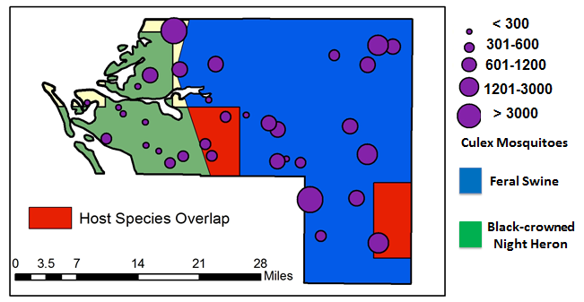
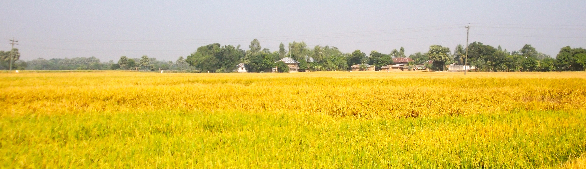
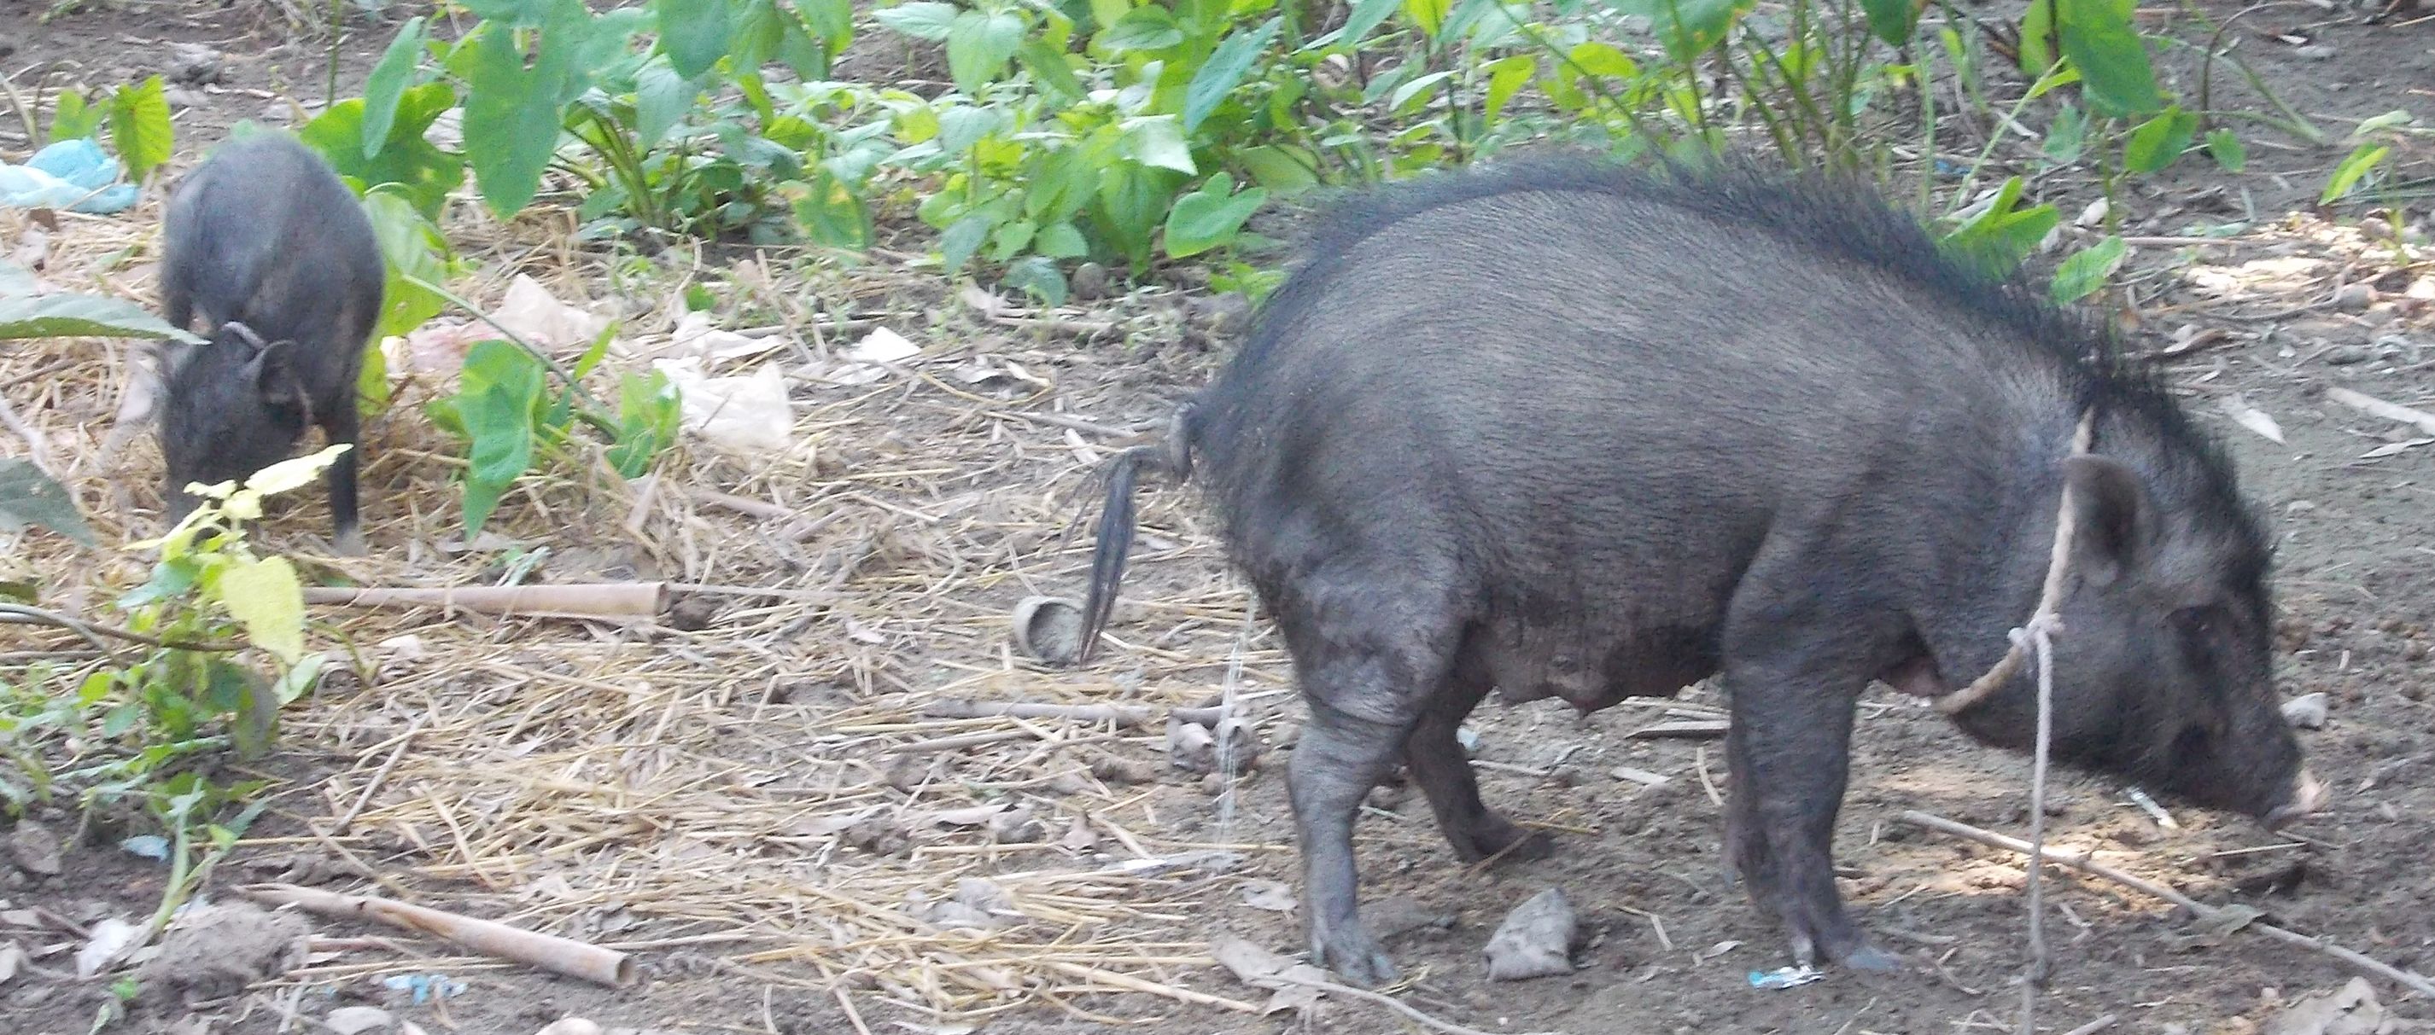
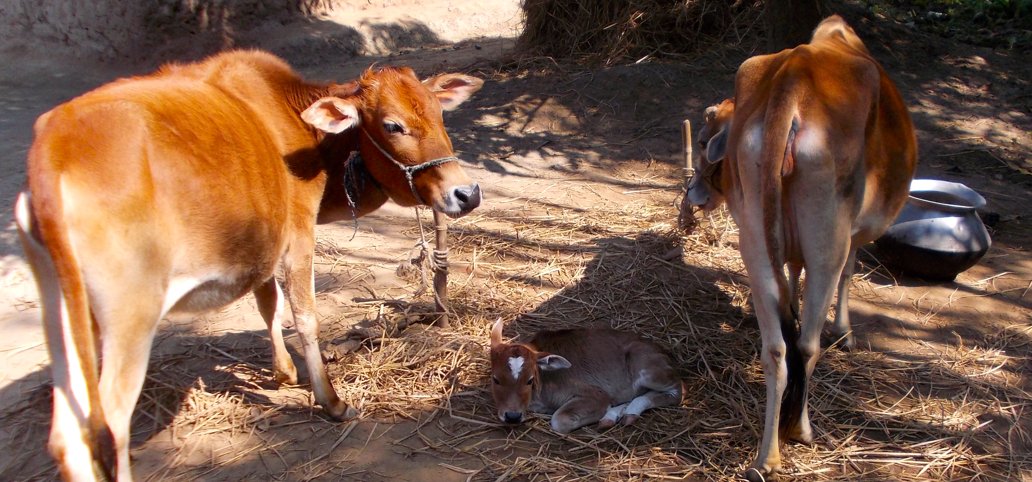

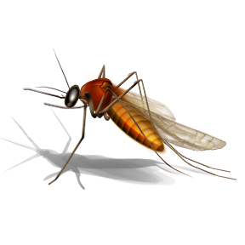



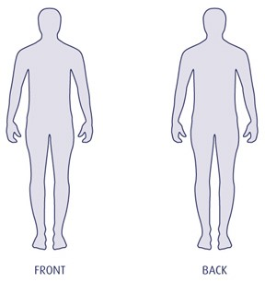
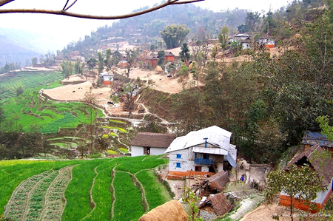
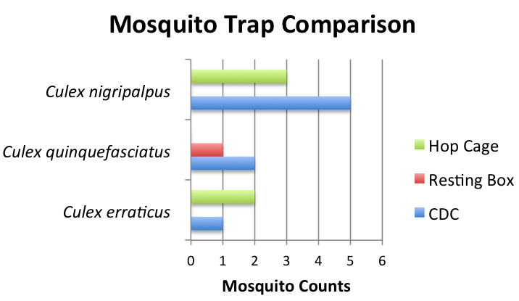
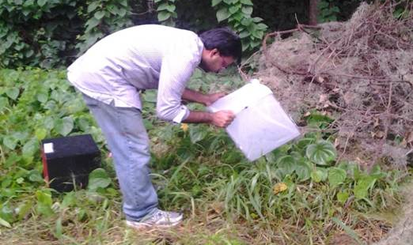
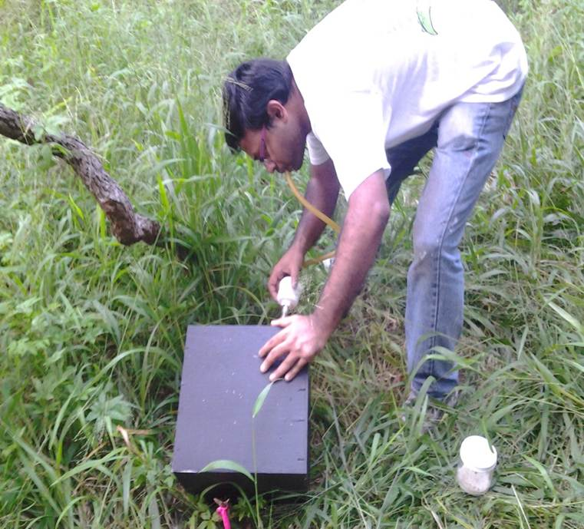
Manatee County Florida
How is Japanese encephalitis virus maintained in a an unusual transmission context?
Which host and vector species are involved in Japanese encephalitis virus transmission in Bangladesh?
- Jennifer Lord
Figure of Viremia profiles
If introduced, could Japanese encephalitis virus invade Florida?
-Jess Rowland
What are the Japanese encephalitis virus viremia profiles in different hosts?
-Brooke Borgert
How do changes in nitrogen and phosphorus within a mosquito affect its ability to acquire and transmit West Nile Virus?
Methods we use:
Statistics
Mathematical Modeling
Molecular Virology
Geographic Information Systems
Field Epidemiology
Mosquito Trapping Techniques
Field Biology
What are the effects of phosphorus on the rate of molecular evolution of West Nile Virus?
-Gabriela Blohm
Which trapping method is ideal for collecting blood fed mosquitoes?
-Biswadeep Dhar
Has Japanese encephalitis virus reached to the animal and human community in mountain districts of Nepal?
-Ajit Kumar Karna

